Slide 1
About this project – This project was my final project for my core subject “Concepts of Programming Languages ”
This project is divided into three parts -
1) Set up a python Virtual Environment with flask
2) Creating a flask application
3) Deploying it to the AWS
Application – In this project, my professor has already told me to make a text file in which I have to write all my activities which are done by me at given time and on top of that I have to write those activities in each text format. Basically, it was a text file which contain data, time and description of what I did on that date and time.

Slide 2
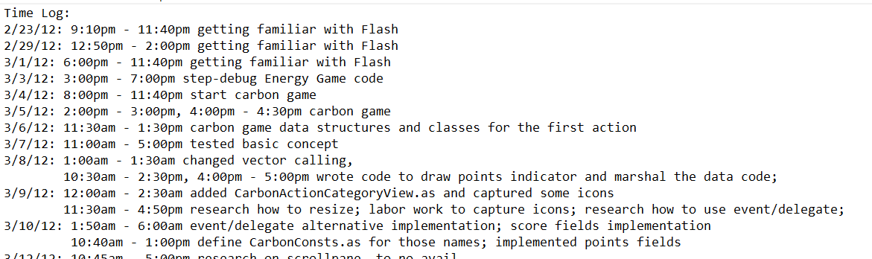
Above is the type of text file which I must create and along side professor has given me 5 other files, which I must parse and calculate all the hours and minute, those hours and minute will decide how much I worked whole semester.
For this application, I have used python to parse all the text file and applied NLTK functions on the text and gathered overall time I have worked according to text file.
NLTK - Tokenize: Words and Sentences, string manipulation, use regex, Character count etc.

Slide 3
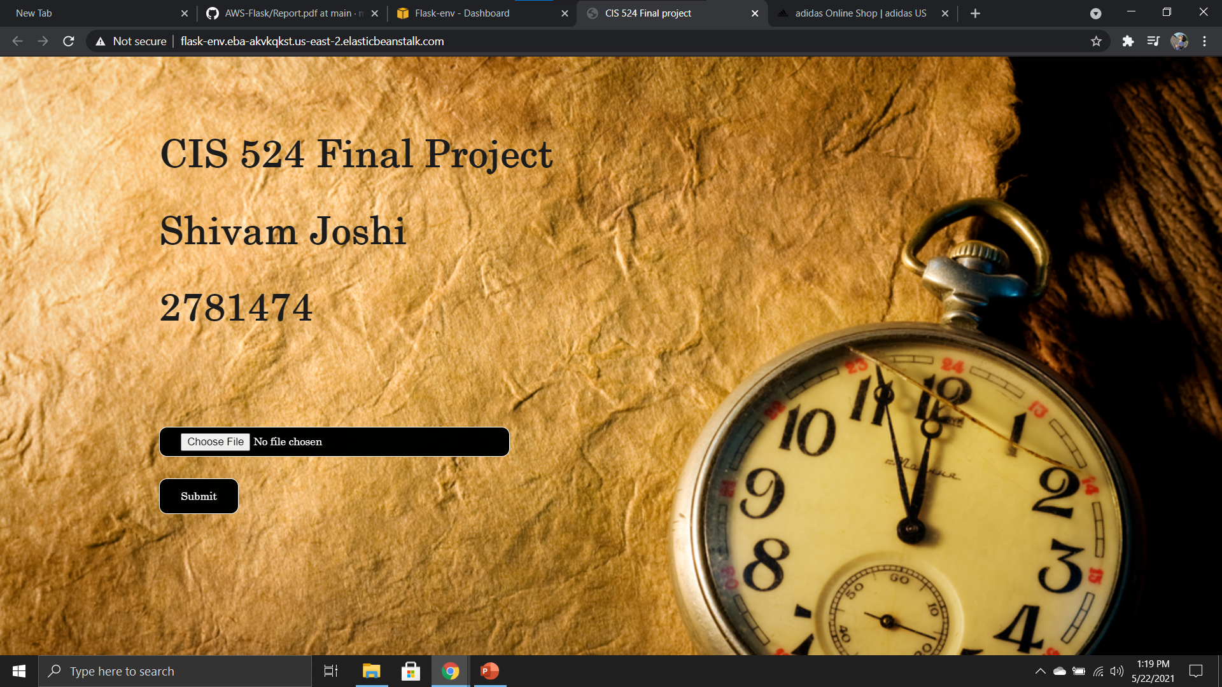
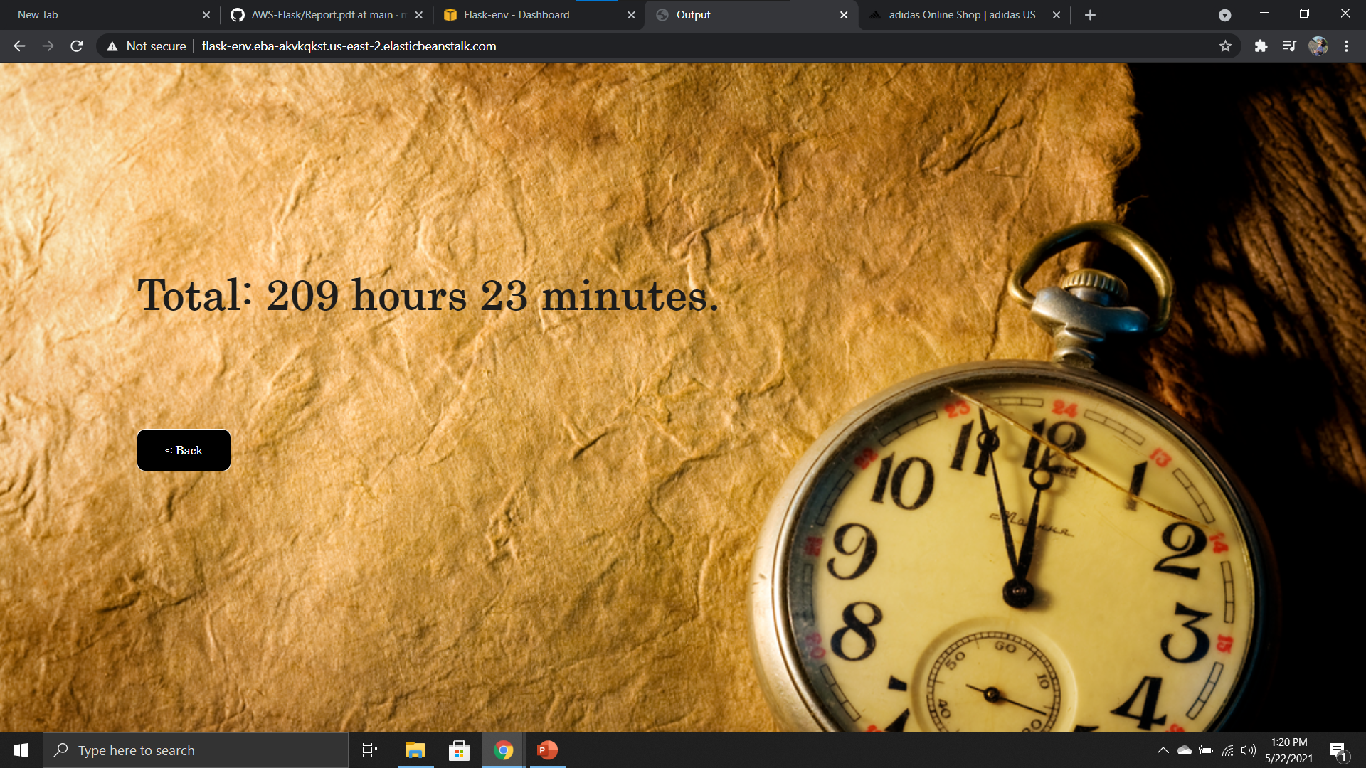
http://flask-env.eba-akvkqkst.us-east-2.elasticbeanstalk.com/
This link is still active you can use it, but in order to process the text file, text file should be in the given format.
Thankyou

